Slide 1




Registration Open Now!
13th International Conference on Geosynthetics
“Legacy, Evolution & Revolution”
13 – 17 September 2026
Palais des congrès de Montréal
Montréal, Canada
www.13icg-montreal.org
Sign Up for the
13 ICG Newsletter!

Slide 2
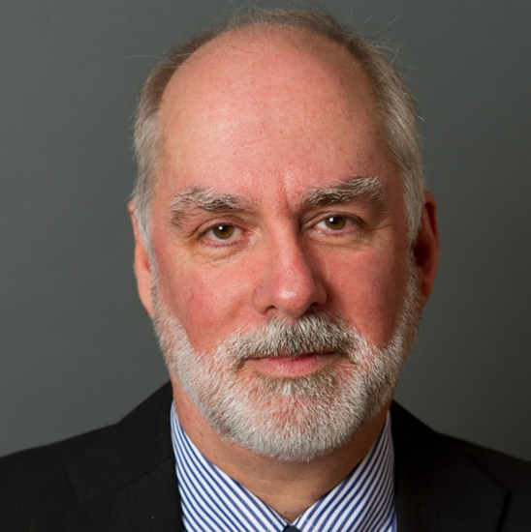
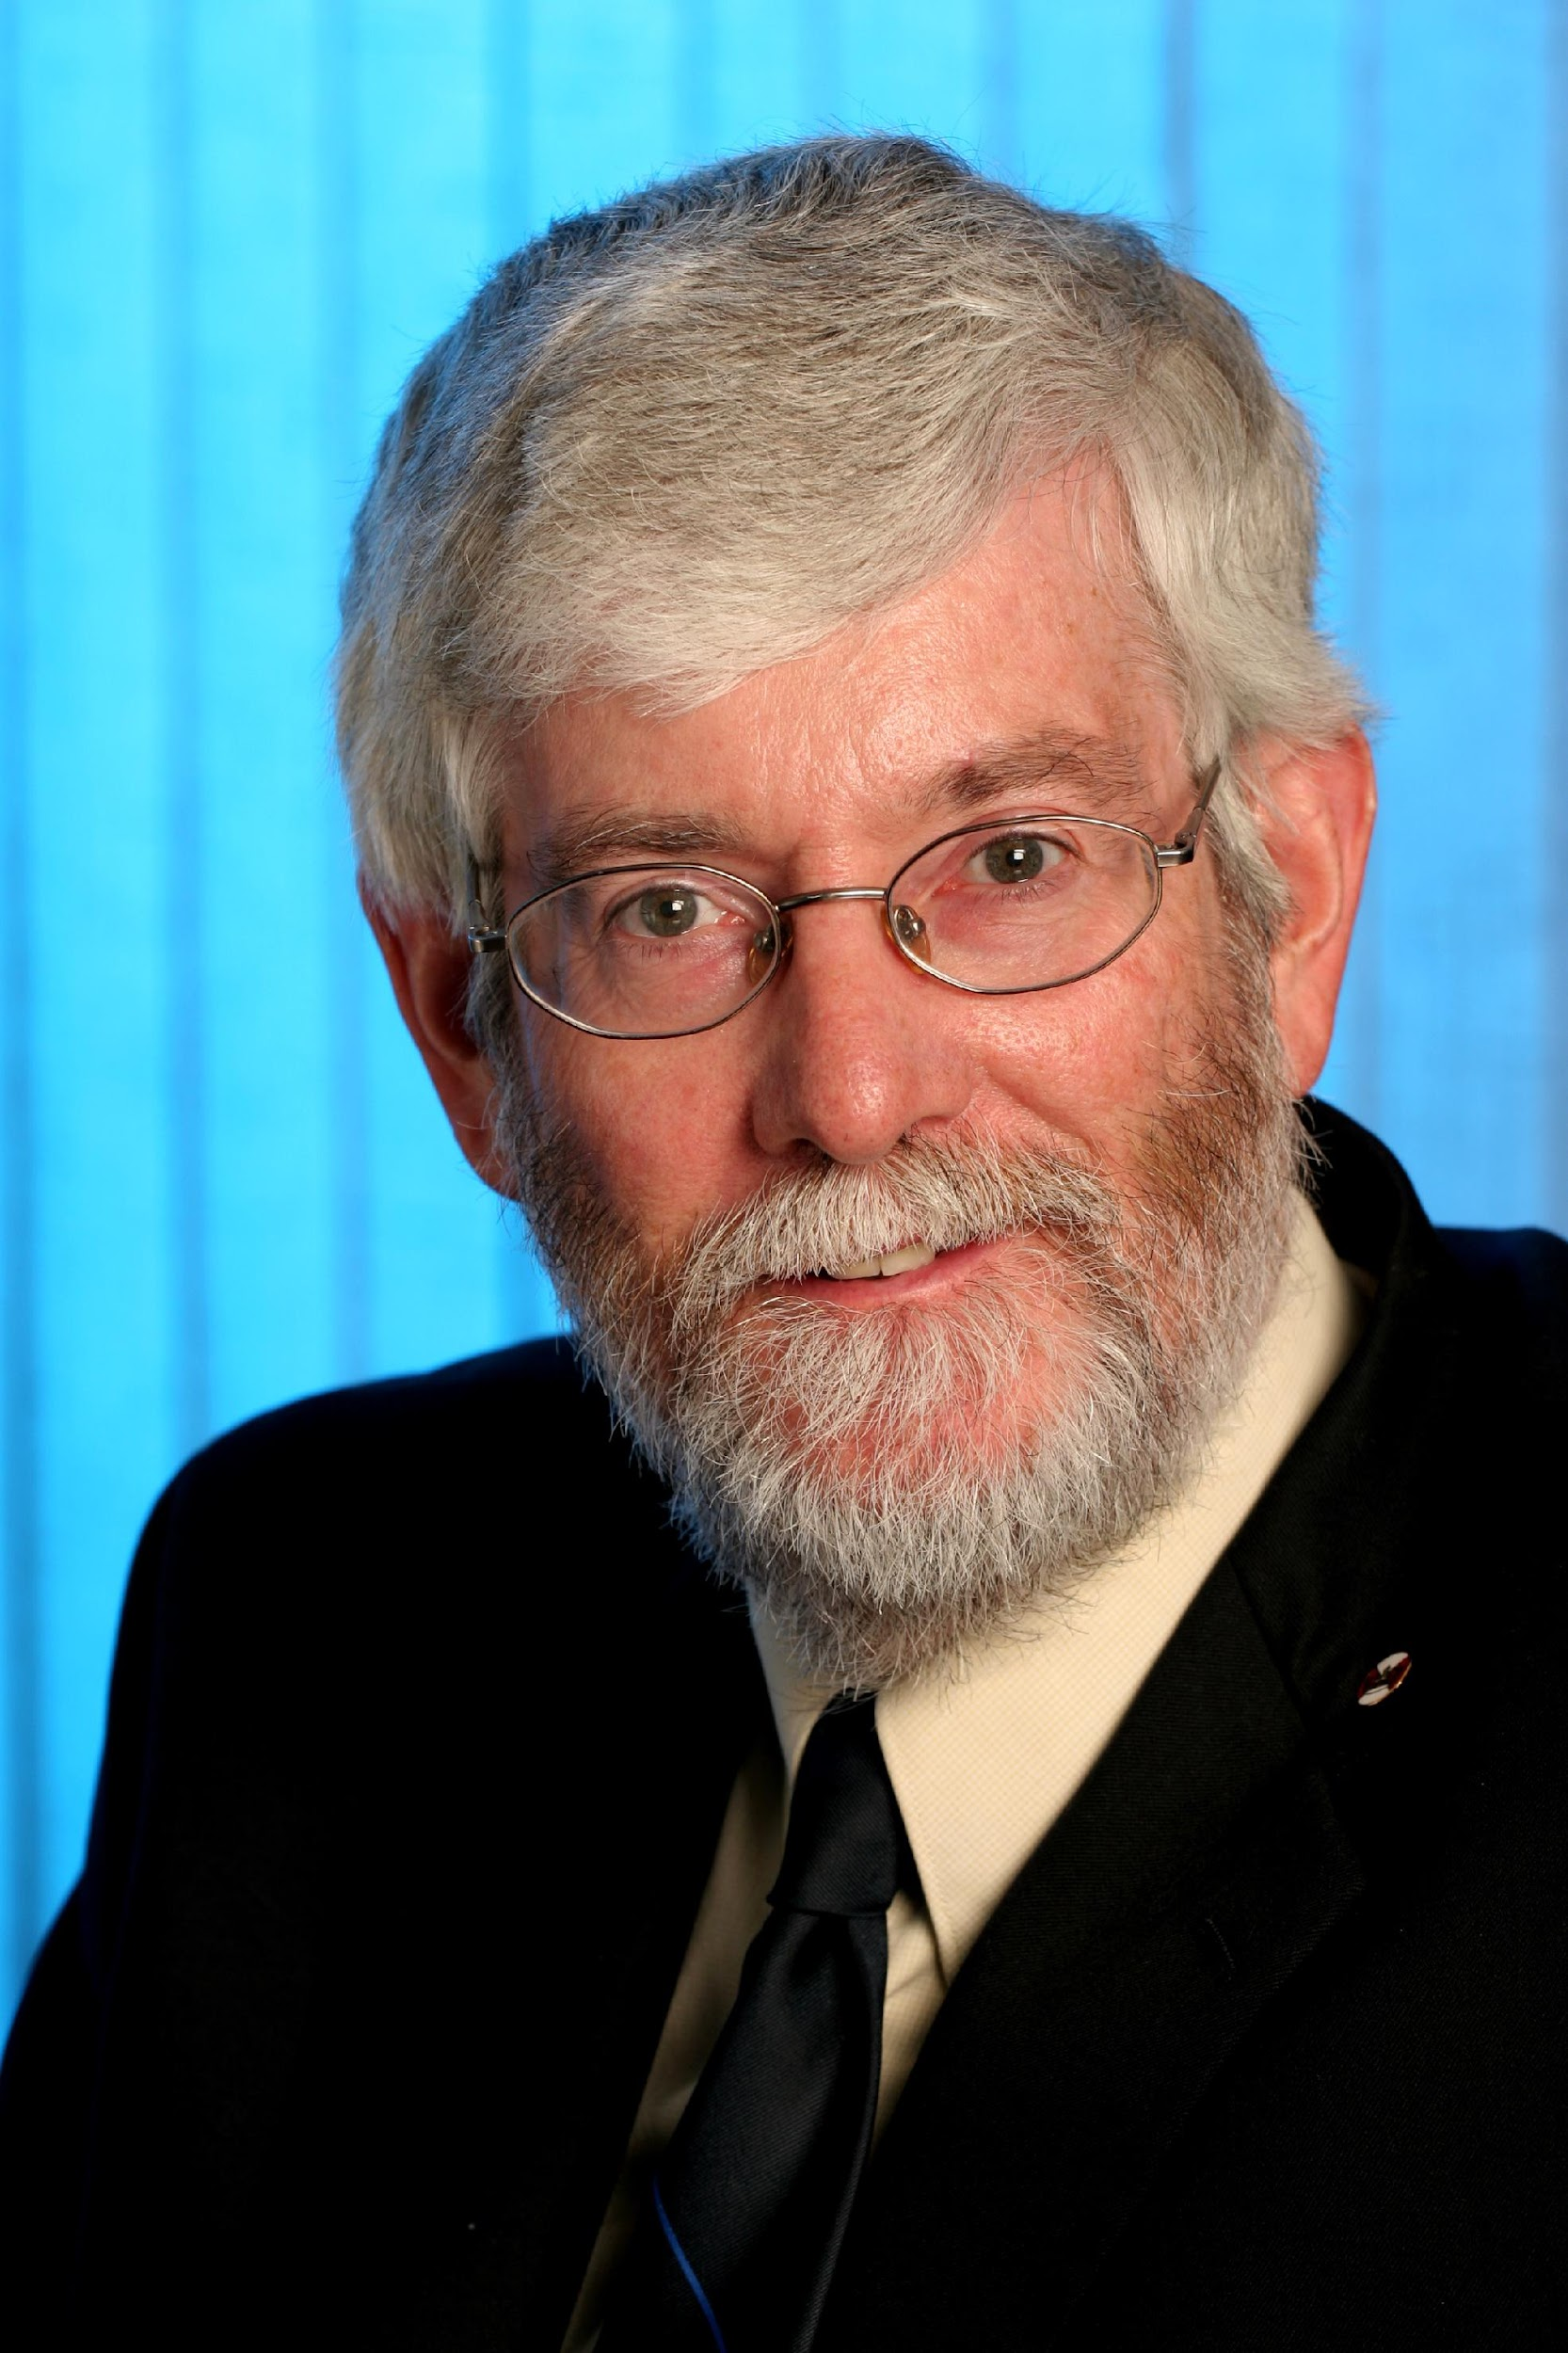
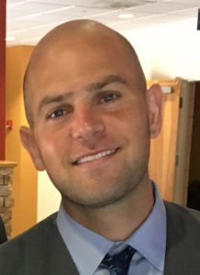
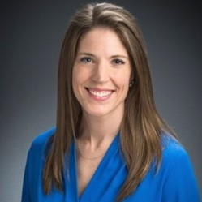

Advisory Co-Chairs
DR. RICHARD BATHURST
DR. KERRY ROWE
KEY TOPICS
Climate Change & Sustainability
Transportation Infrastructure
Mining & Energy
Disaster Mitigation
HIGHLIGHTS
Unmatched Networking
2026 Giroud Lecture
Legends Celebration
UN Global Compact Session
Conference Co-Chairs
DR. BEN LESHCHINSKY
DR. KRISTIN SAMPLE-LORD
www.13icg-montreal.org

Slide 3
Sign Up for the 13 ICG Newsletter!
www.13icg-montreal.org

